Slide 1


Computer Networks
Lectures (Chapter3)
Transport Layer
Subhan Ullah, PhD
subhan.ullah@nu.edu.pk
BS(Computer Science) Fall-2022

Slide 2
Transport layer: overview
Our goal:
understand principles behind transport layer services:
  multiplexing, demultiplexing
  reliable data transfer
  flow control
  congestion control
learn about Internet transport layer protocols:
  UDP: connectionless transport
  TCP: connection-oriented reliable transport
  TCP congestion control

Slide 3

Transport layer: roadmap
Transport-layer services
Multiplexing and demultiplexing
Connectionless transport: UDP
Principles of reliable data transfer
Connection-oriented transport: TCP
Principles of congestion control
TCP congestion control
Evolution of transport-layer functionality

Slide 4
















Transport services and protocols
application
transport
network
data link
physical
provide logical communication between application processes running on different hosts
mobile network
national or global ISP
transport protocols actions in end systems:
  sender: breaks application messages into segments, passes to network layer
  receiver: reassembles segments into messages, passes to application layer
logical end-end transport
local or regional ISP
home network
content
provider
network
application
transport
network
data link
physical
datacenter
network
two transport protocols available to Internet applications
  TCP, UDP
enterprise
network
Notes:
By logical communication , we
mean that from an application’s perspective, it is as if the hosts running the processes
were directly connected; in reality, the hosts may be on opposite sides of the
planet, connected via numerous routers and a wide range of link types. Application
processes use the logical communication provided by the transport layer to send
messages to each other, free from the worry of the details of the physical infrastructure
used to carry these messages.
Let’s look at each of these three (logical communications, actions,

Slide 5
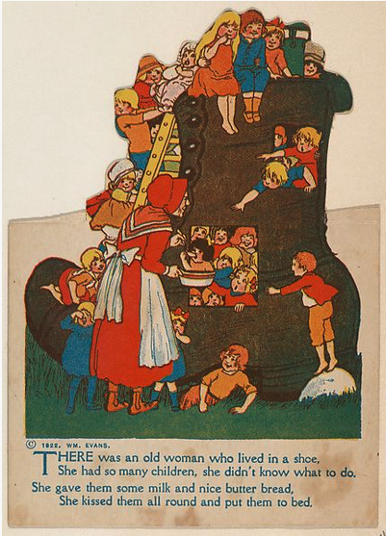
Transport vs. network layer services and protocols
household analogy:
12 kids in Ann’s house sending letters to 12 kids in Bill’s house:
hosts = houses
processes = kids
app messages = letters in envelopes
transport protocol = Ann and Bill who demux to in-house siblings
network-layer protocol = postal service

Slide 6
Transport vs. network layer services and protocols
network layer: logical communication between hosts
transport layer: logical communication between processes
  relies on, enhances, network layer services
household analogy:
12 kids in Ann’s house sending letters to 12 kids in Bill’s house:
hosts = houses
processes = kids
app messages = letters in envelopes
transport protocol = Ann and Bill who demux to in-house siblings
network-layer protocol = postal service

Slide 7
Transport Layer Actions
Sender:
application
application
is passed an application-layer message
app. msg
determines segment header fields values
T_{h}
transport
app. msg
transport
T_{h}
creates segment
network (IP)
network (IP)
passes segment to IP
link
link
physical
physical

Slide 8
Transport Layer Actions
Receiver:
application
receives segment from IP
application
checks header values
transport
transport
app. msg
extracts application-layer message
network (IP)
network (IP)
demultiplexes message up to application via socket
link
link
physical
physical
app. msg
T_{h}

Slide 9
Two principal Internet transport protocols
application
transport
network
data link
physical
TCP: Transmission Control Protocol
  reliable, in-order delivery
  congestion control
  flow control
  connection setup
UDP: User Datagram Protocol
  unreliable, unordered delivery
  no-frills extension of “best-effort” IP
services not available:
  delay guarantees
  bandwidth guarantees
mobile network
national or global ISP
logical end-end transport
local or regional ISP
home network
content
provider
network
application
transport
network
data link
physical
datacenter
network
enterprise
network
Notes:
UDP is a "fire-and-forget" protocol

Slide 10
Chapter 3: roadmap
Transport-layer services
Multiplexing and demultiplexing
Connectionless transport: UDP
Principles of reliable data transfer
Connection-oriented transport: TCP
Principles of congestion control
TCP congestion control
Evolution of transport-layer functionality

Slide 11





HTTP server
client
application
application
HTTP msg
transport
transport
network
transport
network
link
network
link
physical
link
physical
physical

Slide 12
HTTP server
client
application
application
HTTP msg
transport
H_{t}
HTTP msg
transport
network
transport
network
link
network
link
physical
link
physical
physical

Slide 13
HTTP server
client
application
application
HTTP msg
transport
H_{t}
HTTP msg
H_{n}
H_{t}
network
transport
HTTP msg
transport
network
link
network
link
physical
link
physical
physical

Slide 14
HTTP server
client
application
application
transport
transport
network
transport
network
link
network
link
physical
link
physical
physical
H_{n}
H_{t}
HTTP msg

Slide 15

HTTP server
client₁
client₂
application
P-client₁
P-client₂
application
transport
transport
network
transport
network
link
network
link
physical
link
physical
physical

Slide 16
Multiplexing/demultiplexing
multiplexing at sender:
demultiplexing at receiver:
handle data from multiple
sockets, add transport header (later used for demultiplexing)
use header info to deliver
received segments to correct
socket
application
application
P1
P2
application
socket
P3
transport
P4
process
transport
network
transport
network
link
network
link
physical
link
physical
physical

Slide 17
How demultiplexing works
host receives IP datagrams
  each datagram has source IP address, destination IP address
  each datagram carries one transport-layer segment
  each segment has source, destination port number
host uses IP addresses & port numbers to direct segment to appropriate socket
32 bits
source port #
dest port #
other header fields
application
data
(payload)
TCP/UDP segment format
Notes:
Total number of ports: 65535
well known port numbers: 0-1023
Registered port numbers: 1024-49151
Dynamically assigned port numbers: 49152 -65535
A port number is a 16-bit number, ranging from 0 to 65535. The port numbers ranging from 0 to 1023 are called well-known port numbers and are restricted, which means that they are reserved for use by well-known application protocols such as HTTP (which uses port number 80) and FTP (which uses port number 21).

Slide 18
Connectionless demultiplexing
Recall:
when creating socket, must specify host-local port #:
DatagramSocket mySocket1 = new DatagramSocket(12534);
when receiving host receives UDP segment:
  checks destination port # in segment
  directs UDP segment to socket with that port #
when creating datagram to send into UDP socket, must specify
  destination IP address
  destination port #
IP/UDP datagrams with same dest. port #, but different source IP addresses and/or source port numbers will be directed to same socket at receiving host

Slide 19
Connectionless demultiplexing: an example
DatagramSocket serverSocket = new DatagramSocket
(6428);
DatagramSocket mySocket2 = new DatagramSocket
(9157);
DatagramSocket mySocket1 = new DatagramSocket (5775);
application
application
P1
application
P3
P4
transport
transport
network
transport
network
link
network
link
physical
link
physical
physical
source port: 6428
dest port: 9157
source port: ?
dest port: ?
source port: 9157
dest port: 6428
source port: ?
dest port: ?

Slide 20
Connection-oriented demultiplexing
TCP socket identified by 4-tuple:
  source IP address
  source port number
  dest IP address
  dest port number
server may support many simultaneous TCP sockets:
  each socket identified by its own 4-tuple
  each socket associated with a different connecting client
demux: receiver uses all four values (4-tuple) to direct segment to appropriate socket

Slide 21
Connection-oriented demultiplexing: example
application
application
P4
P5
P6
application
P1
P2
P3
transport
transport
network
transport
network
link
network
link
physical
link
physical
server: IP address B
physical
host: IP address A
source IP,port: B,80
dest IP,port: A,9157
host: IP address C
source IP,port: C,5775
dest IP,port: B,80
source IP,port: A,9157
dest IP, port: B,80
source IP,port: C,9157
dest IP,port: B,80
Three segments, all destined to IP address: B,
dest port: 80 are demultiplexed to different sockets

Slide 22
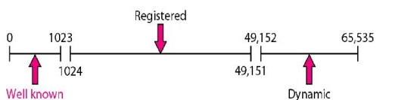
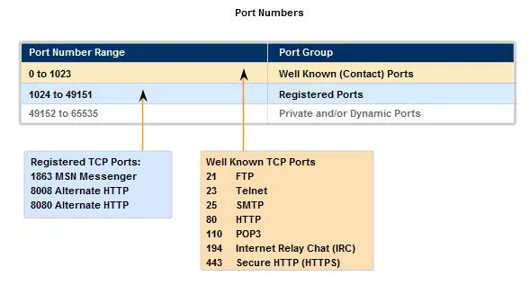
Port numbers
A port number is a 16-bit number, ranging from 0 to 65535
  Well-known port numbers
  Registered port numbers
  Private/Dynamic port numbers also called ephemeral ports
Port numbers are assigned by Internet Assigned Number Authority (IANA )
  To check active TCP and UDP ports: >netstat -a
https://whilenetworking.com/2016/09/03/standard-tcp-ip-port-important-port-numbers/
Notes:
Total number of ports: 65535
well known port numbers: 0-1023
Registered port numbers: 1024-49151
Dynamically assigned port numbers: 49152 -65535
A port number is a 16-bit number, ranging from 0 to 65535. The port numbers ranging from 0 to 1023 are called well-known port numbers and are restricted, which means that they are reserved for use by well-known application protocols such as HTTP (which uses port number 80) and FTP (which uses port number 21).

Slide 23
Summary
Multiplexing, demultiplexing: based on segment, datagram header field values
UDP: demultiplexing using destination port number (only)
TCP: demultiplexing using 4-tuple: source and destination IP addresses, and port numbers
Multiplexing/demultiplexing happen at all layers

Slide 24
Chapter 3: roadmap
Transport-layer services
Multiplexing and demultiplexing
Connectionless transport: UDP
Principles of reliable data transfer
Connection-oriented transport: TCP
Principles of congestion control
TCP congestion control
Evolution of transport-layer functionality

Slide 25
UDP: User Datagram Protocol
Why is there a UDP?
“no frills,” “bare bones” Internet transport protocol
“best effort” service, UDP segments may be:
  lost
  delivered out-of-order to app
no connection establishment (which can add RTT delay)
simple: no connection state at sender, receiver
small header size
no congestion control
  UDP can blast away as fast as desired!
  can function in the face of congestion
connectionless:
  no handshaking between UDP sender, receiver
  each UDP segment handled independently of others

Slide 26
UDP: User Datagram Protocol
UDP use:
  streaming multimedia apps (loss tolerant, rate sensitive)
  DNS
  SNMP
  HTTP/3
if reliable transfer needed over UDP (e.g., HTTP/3):
  add needed reliability at application layer
  add congestion control at application layer

Slide 27

UDP: User Datagram Protocol [RFC 768]
Notes:
read this RFC – it’s only 2.5 pages!

Slide 28
UDP: Transport Layer Actions
SNMP client
SNMP server
application
application
transport
(UDP)
transport
(UDP)
network (IP)
network (IP)
link
link
physical
physical
Notes:
Simple Network Management Protocol (SNMP)

Slide 29
UDP: Transport Layer Actions
SNMP client
SNMP server
UDP sender actions:
application
application
is passed an application-layer message
SNMP msg
transport
(UDP)
transport
(UDP)
determines UDP segment header fields values
UDP_{h}
SNMP msg
UDP_{h}
creates UDP segment
network (IP)
network (IP)
passes segment to IP
link
link
physical
physical

Slide 30
UDP: Transport Layer Actions
SNMP client
SNMP server
UDP receiver actions:
application
receives segment from IP
application
checks UDP checksum header value
transport
(UDP)
transport
(UDP)
SNMP msg
extracts application-layer message
network (IP)
network (IP)
SNMP msg
UDP_{h}
demultiplexes message up to application via socket
link
link
physical
physical

Slide 31
UDP segment header
32 bits
source port #
dest port #
length
checksum
application
data
(payload)
length, in bytes of UDP segment, including header
data to/from application layer
UDP segment format

Slide 32

UDP checksum
Goal: detect errors (i.e., flipped bits) in transmitted segment
1st number
2nd number
sum
Transmitted: 5 6 11
Received: 4 6 11
receiver-computed
checksum
=
sender-computed
checksum (as received)

Slide 33
UDP checksum
Goal: detect errors (i.e., flipped bits) in transmitted segment
sender:
treat contents of UDP segment (including UDP header fields and IP addresses) as sequence of 16-bit integers
checksum: addition (one’s complement sum) of segment content
checksum value put into UDP checksum field
receiver:
compute checksum of received segment
check if computed checksum equals checksum field value:
  Not equal - error detected
  Equal - no error detected. But maybe errors nonetheless? More later ….
https://www.rfc-editor.org/info/rfc1071

Slide 34
Internet checksum: an example
example: add two 16-bit integers
1 1 1 0 0 1 1 0 0 1 1 0 0 1 1 0
1 1 0 1 0 1 0 1 0 1 0 1 0 1 0 1
wraparound
1 1 0 1 1 1 0 1 1 1 0 1 1 1 0 1 1
sum
1 0 1 1 1 0 1 1 1 0 1 1 1 1 0 0
Checksum
0 1 0 0 0 1 0 0 0 1 0 0 0 0 1 1
Note: when adding numbers, a carryout from the most significant bit needs to be added to the result
Check the correctness: add the check sum value with the sum of two integers. If the result is 1 for all bits then accept otherwise reject it.
1 complement of sum
1 1 1 1 1 1 1 1 1 1 1 1 1 1 1 1: Accept otherwise Reject

Slide 35
Internet checksum: weak protection!
example: add two 16-bit integers
0 1
1 1 1 0 0 1 1 0 0 1 1 0 0 1 1 0
1 0
1 1 0 1 0 1 0 1 0 1 0 1 0 1 0 1
wraparound
1 1 0 1 1 1 0 1 1 1 0 1 1 1 0 1 1
Even though numbers have changed (bit flips), no change in checksum!
sum
1 0 1 1 1 0 1 1 1 0 1 1 1 1 0 0
checksum
0 1 0 0 0 1 0 0 0 1 0 0 0 0 1 1

Slide 36
Summary: UDP
“no frills” protocol:
  segments may be lost, delivered out of order
  best effort service: “send and hope for the best”
UDP has its plusses:
  no setup/handshaking needed (no RTT incurred)
  can function when network service is compromised
  helps with reliability (checksum)
build additional functionality on top of UDP in application layer (e.g., HTTP/3)

Slide 37
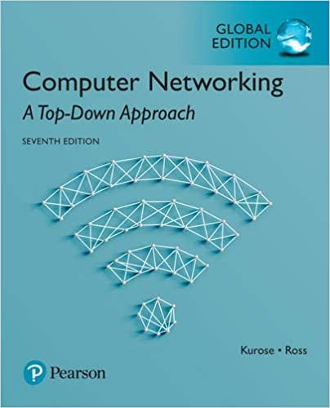
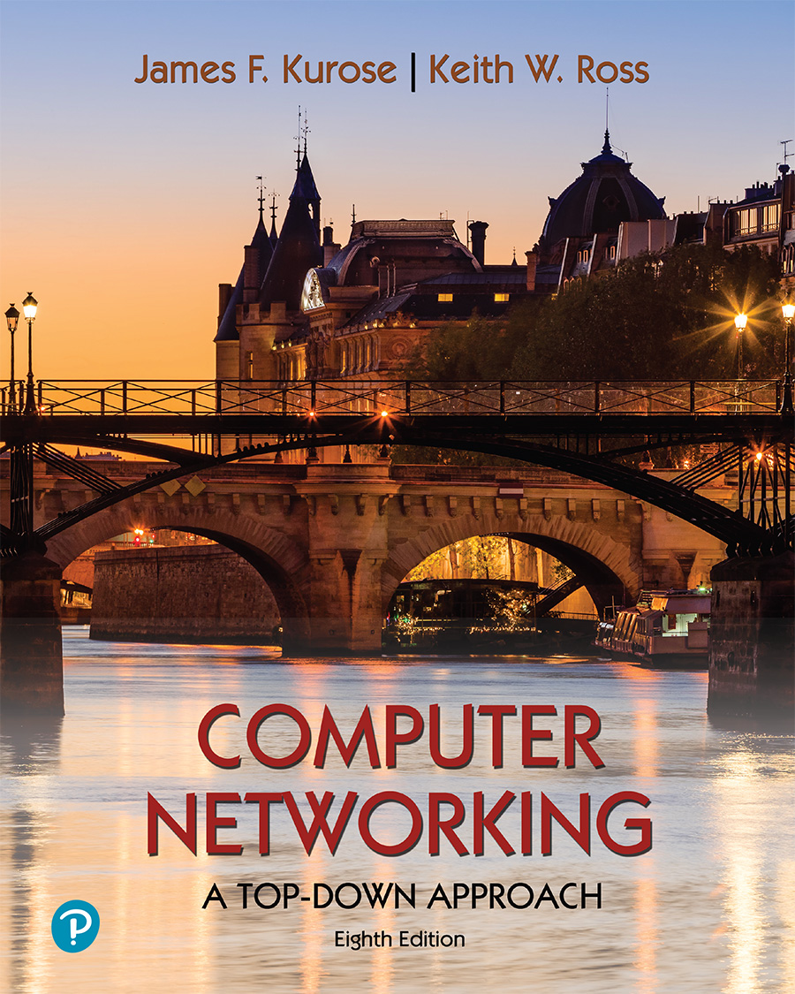
Thank You All
☺
?
A note on the origin of these ppt slides:
All material copyright 1996-2020 J.F Kurose and K.W. Ross, All Rights Reserved
These slides are freely provided by the book authors and it represents a lot of work on their part. We would like to thank J.F Kurose and K.W. Ross.
Transport Layer: 3-150
Notes:
Section F and G ended

